Slide 1


June , 30th 2025
June , 30th 2025
INTERIM REPORT
導入AI於Monte Carlo分析電力系統韌性: Power System Reliability Assessment Using Monte Carlo OPF Simulation and Fully Connected Neural Network
Outline
INSTITUT TEKNOLOGI
BANDUNG
April,22nd 2026
吳有基教授
COMMITTEES:
Smart System lab
電氣工程系

Slide 2
Table of Contents
01
Research Background
06
FCNN Model & Performance
Power system reliability, typhoon hazard context
Architecture, training, R² = 0.9989
02
Research Objectives
07
Line Outage Analysis
Goals and scope of the study
Critical line identification
03
Methodology
08
ENS Distribution & Survivability
Monte Carlo OPF + FCNN pipeline
OPF vs FCNN comparison
04
System Description
09
Conclusions & Future Work
IEEE 14-bus system & generator data
Key findings and 6-item roadmap
05
Monte Carlo OPF Results
33,600 simulation runs, EENS analysis

Slide 3
Research Background
Context & Motivation
Problem Statement
Taiwan faces frequent typhoon events causing widespread transmission outages
Traditional reliability assessment requires computationally expensive AC OPF solves
Energy Not Served (ENS) quantification is critical for grid planning
Real outage data from Taiwan Power Company (Taipower) integrated
Four typhoon events analyzed: Danas, Kong-rey, Gaemi, Krathon
How can we rapidly estimate ENS across thousands of outage scenarios without re-running full AC OPF every time?
⚡ Typhoon Impact
🔢 Computation
4 major events
70% FOR in Kong-rey
33,214 scenarios generated
33,600 OPF runs
200 weekly samples
100% convergence rate

Slide 4
Research Objectives
01
02
Build Monte Carlo OPF Dataset
Train FCNN Surrogate Model
Generate 33,600 AC OPF solutions across 200 weekly scenarios integrating real typhoon hazard data from Taipower records.
Develop a Fully Connected Neural Network achieving R² ≥ 0.99 for fast ENS prediction without repeated OPF computation.
03
04
Critical Line Identification
Survivability Assessment
Identify the most vulnerable transmission lines by outage frequency and ENS contribution (ΔENS analysis).
Validate OPF vs FCNN survivability curves at multiple demand thresholds (0.6–1.0 pu), per typhoon scenario.

Slide 5
03
Methodology
Rexplan pipeline: Julia (PowerModels.jl) + Python (PyTorch)
References:
reXplan Project Team, “reXplan-repo”, GitHub repository. Available: https://github.com/reXplan-project/reXplan-repo
M. Cosovic, “JuliaGrid.jl – Optimal Power Flow API”, Documentation. Available: https://mcosovic.github.io/JuliaGrid.jl/dev/api/optimalPowerFlow/

Slide 6
Methodology — Two-Stage Pipeline
Excel Input
Monte Carlo
OPF (Julia)
Dataset
33,214 rows
FCNN
Training (Python)
R² = 0.9994
MAE = 0.50 MW
▶
▶
▶
▶
Generator costs
Typhoon FOR data
200 samples
168 hrs each
35 features
+ ENS target
PyTorch
200 epochs
Test set
evaluation
Why Custom Pipeline Instead of reXplan?
Data Incompatibility
Full OPF Control
reXplan uses European network formats; Taiwan-specific data (NTD cost curves, Taipower FOR) required custom handling
Direct use of PowerModels.jl enables custom fictitious generators, VOLL parameterization, and load shedding
Novel FCNN Contribution
Benchmark Reproducibility
reXplan does not support standalone FCNN surrogates trained on custom Monte Carlo datasets
IEEE 14-bus is an internationally standard benchmark enabling direct literature comparison

Slide 7
04
System Description
IEEE 14-Bus Test System & Generator Data from Taipower

Slide 8
IEEE 14-Bus System & Generator Configuration
System Specifications
Generator Data — Real Taipower Cost Curves
14 Buses
nodes in the network
Gen
Bus
Pmax (MW)
Marginal Cost
Plant
20 Branches
transmission lines & transformers
Gen 1
1
332.4 MW
1.87 NTD/MWh
協和 #3
5 Generators
at buses 1, 2, 3, 6, 8
Gen 2
2
140.0 MW
2.20 NTD/MWh
協和 #4
11 Load Buses
buses 2,3,4,5,6,9,10,11,12,13,14
Gen 3
3
100.0 MW
2.94 NTD/MWh
林口 #1
259 MW
total base load (100 MVA base)
Gen 4
6
100.0 MW
3.13 NTD/MWh
林口 #2
AC OPF
ACPPowerModel via PowerModels.jl
Gen 5
8
100.0 MW
3.09 NTD/MWh
林口 #3
Seed = 42
full reproducibility guaranteed
C(P) = a·P² + b·P + c (NTD/hr)

Slide 9
05
Monte Carlo OPF Simulation
33,600 AC OPF runs · 200 weekly scenarios · 4 typhoon events

Slide 10
Monte Carlo OPF — Simulation Parameters & Typhoon Hazard
Simulation Parameters
Typhoon Hazard Data (Taipower Records)
Samples (N)
200 weekly scenarios
Typhoon
Line
Outages
Trans.
Outages
FOR (%)
Hours/sample
168 h (7 days × 24 h)
丹娜絲 Danas
45
6
55.0%
Total OPF runs
33,600 — all converged
康芮 Kong-rey
90
16
70.0%
Typhoon share
25% (50 samples)
凱米 Gaemi
20
4
35.0%
Formulation
AC OPF (ACPPowerModel)
Solver
Ipopt — interior-point
小犬 Krathon
32
8
47.5%
Load model
±5% Gaussian noise
Baseline avg.
—
—
51.9%
Random seed
42 (reproducible)
Kong-rey = most severe; Gaemi = least severe

Slide 11
Monte Carlo OPF — Key Results
4,806
5,579
4,549
200/200
MWh/week
MWh/week (+22.6%)
MWh/week
samples (100%)
EENS (All Scenarios)
Typhoon EENS
Baseline EENS
Convergence
Simulation Results Summary
Metric
Value
Note
EENS — all samples
4,806.55 MWh/week
Mean over 200 scenarios
Standard Deviation
4,564.85 MWh/week
High variance under typhoon conditions
EENS — baseline scenarios
4,549.18 MWh/week
Normal operation (150 samples)
EENS — typhoon scenarios
5,578.65 MWh/week
25% typhoon share (50 samples)
Min / Max ENS
0.00 / 16,770.78 MWh
Best week vs worst week

Slide 12
06
Fully Connected Neural Network
Surrogate model for fast ENS prediction — R² = 0.9994

Slide 13
FCNN — Architecture & Input Features
Layer Architecture (53,441 parameters)
Input Feature Groups (35 total)
Input
35
—
—
🔵 Demand per bus
11 features
Active power demand at each load bus (MW)
🟠 Line status
20 features
Binary: 1 = in service, 0 = outage
Hidden 1
256
ReLU
BatchNorm + Dropout 0.2
🟢 Temporal
2 features
Hour of day (0–23) & day of week (0–6)
🔴 Scenario
2 features
is_typhoon flag + forced outage rate (FOR)
Hidden 2
128
ReLU
BatchNorm + Dropout 0.2
Hidden 3
64
ReLU
BatchNorm + Dropout 0.2
Training Configuration
Framework:
PyTorch (Python 3.10)
Hidden 4
32
ReLU
BatchNorm + Dropout 0.2
Optimizer:
Adam (LR = 1×10⁻³)
Output
1
Linear
—
LR Scheduler:
ReduceLROnPlateau (patience=10, factor=0.5)
Epochs / Batch:
200 epochs, batch size 256

Slide 14
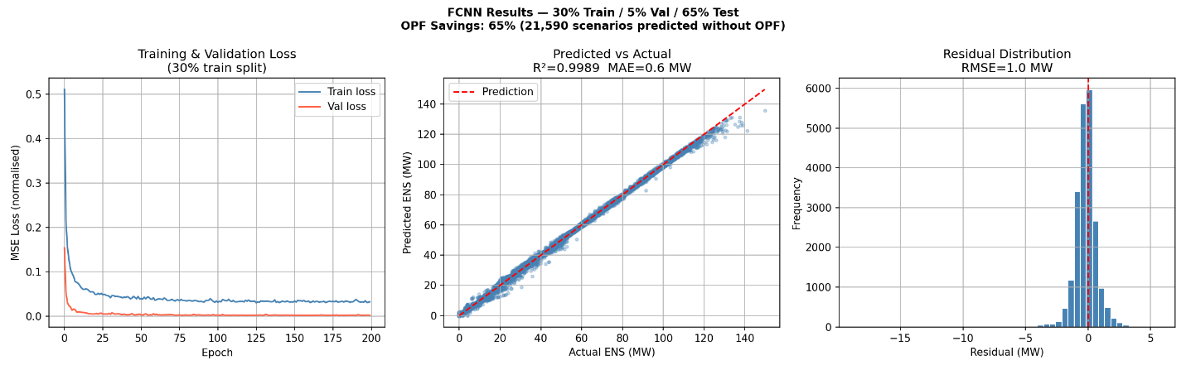
FCNN — Model Performance

Slide 15
FCNN — Model Performance
0.9994
0.50 MW
0.69 MW
200/200
99.94% variance explained
mean absolute error
vs ENS range 0–152 MW
OPF samples converged
R² Score
MAE
RMSE
Convergence
ENS Statistical Comparison — OPF vs FCNN (Test Set: 3,322 Scenarios)
Statistic
OPF (Ground Truth)
FCNN Prediction
Relative Difference
Mean (MW)
28.30
28.43
0.46%
Median (MW)
15.87
15.48
2.46%
Std. Dev. (MW)
29.25
29.05
0.68%
Skewness
1.173
1.175
0.17%
Kurtosis
0.538
0.525
2.42%
Near-perfect agreement across all 5 statistical metrics confirms FCNN fully captures the ENS distribution.

Slide 16
Line Outage Analysis — Frequency & ENS Contribution
Top 5 Most Frequent Outage Lines
Top 5 Most Critical Lines by ΔENS
Line 16
57.4%
Line 4
+18.99 MW
19,066 hrs
38.61 MW when out
Line 14
56.6%
Line 20
+17.10 MW
18,801 hrs
37.94 MW when out
Line 2
54.2%
Line 9
+15.58 MW
18,011 hrs
36.49 MW when out
Line 8
54.0%
Line 14
+14.86 MW
17,944 hrs
35.39 MW when out
Line 12
53.9%
Line 7
+14.81 MW
17,891 hrs
36.48 MW when out

Slide 17
Survivability Analysis — OPF vs FCNN
Survivability at Key Demand Thresholds — OPF vs FCNN (3,322 scenarios)
Threshold
Demand Met
OPF Survivability
FCNN Survivability
Agreement
0.60 pu
60%
~98%
~98%
✓ Perfect
0.70 pu
70%
~90%
~90%
✓ Perfect
0.80 pu
80%
71.8%
71.8%
✓ Perfect
0.90 pu
90%
54.7%
54.7%
✓ Perfect
1.00 pu
100%
~0%
~0%
✓ Perfect
Typhoon Scenario Severity Comparison
70.0%
47.5%
55.0%
35.0%
Forced Outage Rate (FOR)
Gaemi
Krathon
Danas
Kong-rey

Slide 18
09
Conclusions & Future Work
Summary of findings and 6-item research roadmap

Slide 19
Conclusions — Key Findings
Summary of Key Results
Category
Finding
EENS (all scenarios)
4,806.55 MWh/week
Typhoon vs Baseline
5,578.65 vs 4,549.18 MWh/week → +22.6% under typhoon conditions
FCNN Performance
R² = 0.9994 | MAE = 0.50 MW | RMSE = 0.69 MW — near-perfect accuracy
Most Frequent Outage
Line 16 (57.4% of scenarios)
Most Critical Line (ΔENS)
Line 4 — ΔENS = +18.99 MW
Survivability @ 0.9 pu
54.7% (OPF = FCNN — perfect agreement)
①
②
③
Data-Driven Pipeline Works
Typhoon Impact is Significant
FCNN = OPF Surrogate Verified
The complete Monte Carlo OPF + FCNN framework achieves near-perfect ENS prediction (R²=0.9994), enabling fast reliability assessment without repeated OPF runs.
Typhoon scenarios increase EENS by +22.6% vs baseline. Kong-rey (FOR 70%) shows the lowest survivability; Gaemi (FOR 35%) the highest.
OPF and FCNN survivability curves overlap perfectly at all demand thresholds (0.6–1.0 pu), confirming that FCNN fully preserves reliability characteristics.

Slide 20
Future Work
01
Generator Outage Analysis (Case 14)
02
Realistic Baseline FOR
03
Unit Commitment Integration
Regenerate dataset with generator status features (gen_bus1,2,3,6,8), expanding to 40 inputs. Retrain FCNN for joint line + generator reliability analysis.
Incorporate non-typhoon historical outage data to establish representative baseline FOR (typically 2–10% for transmission lines), replacing the current typhoon-derived 51.9%.
Extend to Security-Constrained Unit Commitment (SCUC) model incorporating generator startup costs for more accurate total cost and dispatch estimation.
04
Expanded Monte Carlo Dataset
05
Real Network Application
06
reXplan FCNN Integration
Increase samples from 200 to 1,000+ and add more typhoon events to improve EENS statistical robustness and FCNN generalization across rare extreme scenarios.
Apply the complete framework to a real Taiwanese network topology (Taipower grid) where generator assignments are physically meaningful, replacing the IEEE 14-bus benchmark.
Integrate the FCNN surrogate component into reXplan's workflow, combining its robust spatiotemporal hazard modeling with the speed and accuracy of neural network ENS prediction.

Slide 21
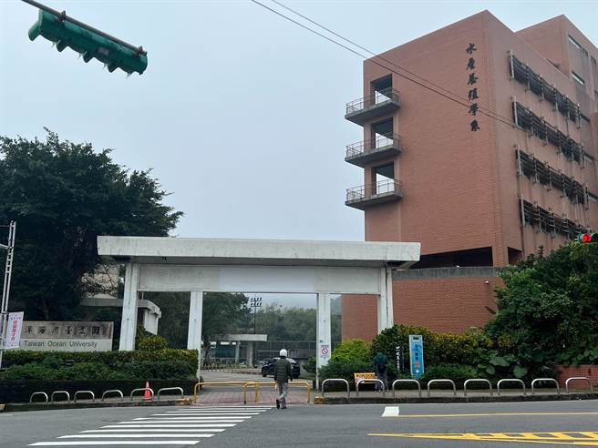
Thank You

